Slide 1

Reporting Students with Disabilities
State Aid & Financial Planning Service
ONC BOCES
November 28, 2017

Slide 2
Reporting Public Placements Aided through STAC Online System
Steps:
Identify Student & Program
File Appropriate STAC
Update & Verify
Receive Aid

Slide 3
Reporting Public Placements for Public Excess High Cost Aid
Definition:
Aid for resident students with disabilities served in a public school or BOCES program, for whom the annualized cost exceeds 3 times the district’s AOE/TAPU (PUB output report)
Formula:
Annual program cost - (3 x AOE/TAPU) x FTE x Aid Ratio
Aid Claim Process:
  File for all district operated, BOCES and other public school programs that exceed High Cost threshold
  Always Report Annualized Cost on STAC form
  Check detailed PUB Report for all submissions
  Enrollment dates and tuitions must be verified online by specified due date
  Aid is paid year following student’s enrollment

Slide 4
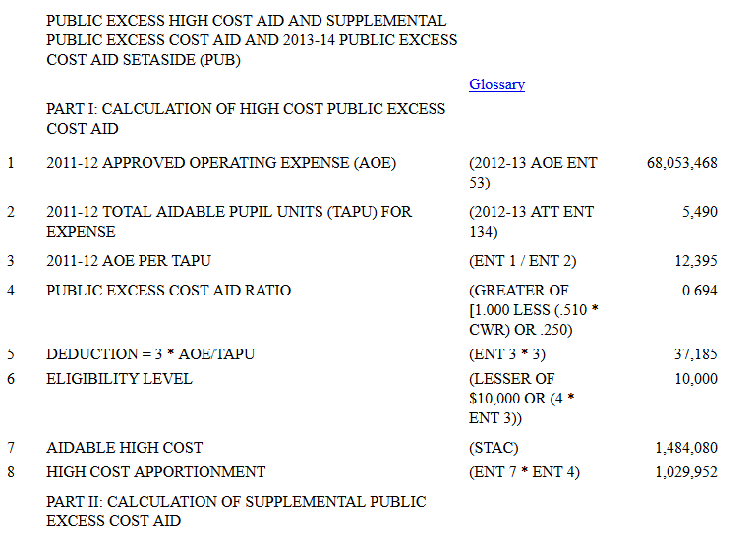
Public Excess High Cost Aid Output Report
Tuition 75,000
Threshold 37,185
Excess 37,815
x Aid Ratio 0.694
26,243.61
X FTE 1.0
PUB HC Aid 26,243.61
Aid Ratio
Threshold

Slide 5
Public Placements (District Operated)
Items to include:
Direct services to the child that are listed on the I.E.P:
  Salaries and benefits of special education teachers and aides/assistants
  Itinerant services
  Related services
  Special equipment (in the year of purchase)
    Braille reader, special chair etc.
Do not include:
  Supplies and materials
  Salary benefits for district staff paid out of a grant
  Operations and maintenance
  Evaluation costs
  Transportation (only include on STACs for summer)

Slide 6
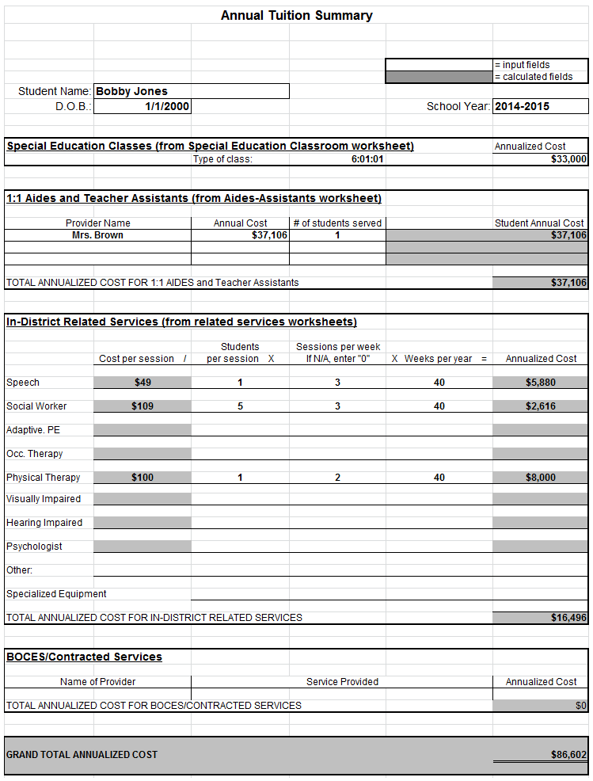

Slide 7
Calculating Cost for In-District Placements
Use actual enrollment in class

Slide 8
Calculating Cost for In-District Placements
Make sure staff is not paid out of grant money

Slide 9
Calculating Cost for In-District Placements

Slide 11
Private Placement Process
Steps:
Identify Student & Placement
Add DCERT (10-month only)
File Appropriate STAC
Update & Verify online
Receive Aid

Slide 12
Reporting Students for Private Excess Cost Aid
Definition:
Payable for students with disabilities placed in approved in-state and out-of-state private schools
    Residential and Non Residential
    Rome and Batavia
    Special Act Union Free School Districts
    Out-of-State Placements
Formula:
(Approved tuition – basic contribution) x FTE x Aid Ratio Tuition is set by SED

Slide 13
Private Placement Certification (DCERT) Requirements
10-Month School Age Private Placements only
Annual basis
  Day In-State
  Day Out-of-State
  Residential In-State
  Residential Out-of-State
Required for the following instances:
  Student changes placement type
    (day to residential or in-state to out-of-state)
  Student changes district
    (change in CSE)
  Student goes from preschool to school age

Slide 14
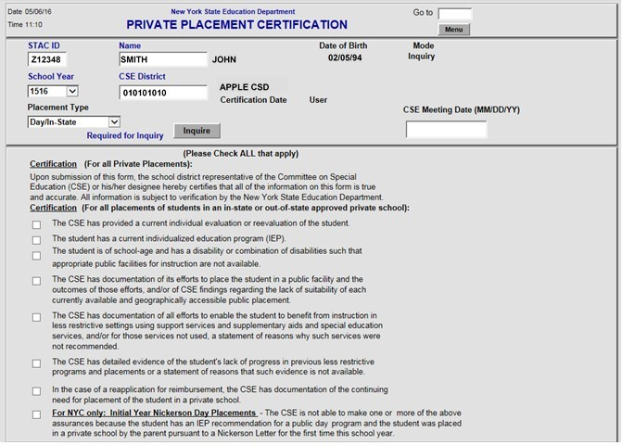
DCERT Screen
New Field:
CSE Meeting Date
– Must be before or equal to certification date

Slide 15
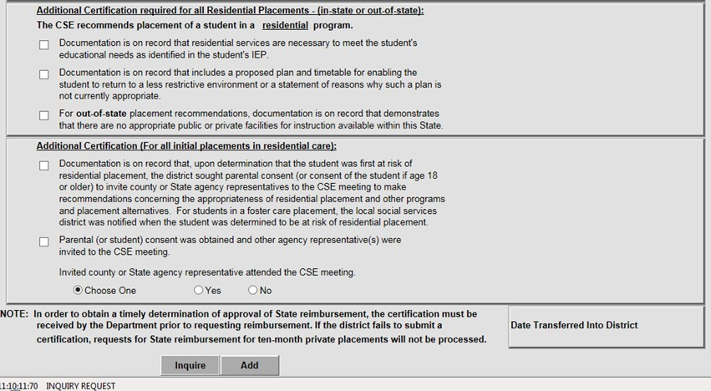
DCERT Screen (continued)

Slide 16
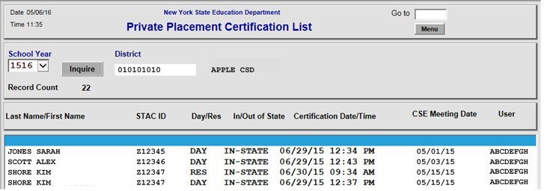
DQCER Screen

Slide 17
Private Placement Certification (DCERT)
  Utilize reports to ensure accurate submissions:
    DQAPP (Agency Approval List)
    DQCER (Private Placement Certification List)
  School districts must continue to submit out-of-state packets along with paper STAC-1 forms:
    Reapplications were due June 1
    http://www.p12.nysed.gov/specialed/applications/outofstate/Placements-Out-of-State-Residential-Schools.html

Slide 18
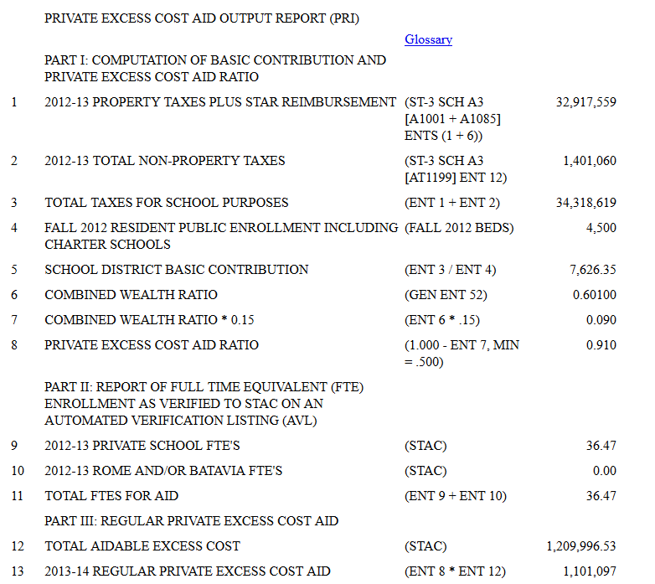
Private Excess Cost Aid Output Report
Tuition 75,000.00
Basic Cont. 7,626.35
Excess 67,373.65
x Aid Ratio 0.910 PRI EC Aid 61,310.02
Basic Contribution
Aid Ratio
FTE’s

Slide 19
Aid Claim Process for Private Placements
  Private Placement Pre-Approval must be entered via STAC on-line
  District must file STAC forms in order to generate aid
  Aid is paid the year following students enrollment
  38.424% of maintenance costs for CSE residential placements will be paid by district
    No aid generated on 38.424% district share

Slide 20
Reporting Students for Summer School Aid
Also called Section 4408 aid
Definition:
School-age students (public and private) with disabilities educated during July and August
Formula:
Reimbursed at 80% of the approved cost of education, transportation and maintenance
  Exception: Chapters 47, 66 and 721 reimbursed at 100% of the approved cost

Slide 21
Summer School Aid Claim Process
RSU Schedules
STAC online system
  Verification:
  After summer school is complete
  Verify education then transportation (separately)
  Statute of Limitations, 3 years
  Payments:
  Initial payment based on prospective rates
  Adjustments made in future payments

Slide 22
Reporting Students for Homeless Aid
Only non-resident homeless students from another district in New York State who have designated your district as their educating district are eligible for state aid reimbursement through the STAC online system
Applies to regular education students or students with disabilities who are homeless

Slide 23
Reporting Students for Homeless Aid
No minimum expense is required
  No threshold
Aid is paid at 100% of approved tuition cost
  Based on NRT rate or out of district program costs
Transportation costs are reported on the ST-3 along with other 10-month transportation you are claiming
District of Origin is responsible for the basic contribution which is deducted from state aid
  Last residence before the student became homeless

Slide 24
Reporting Students for Homeless Aid
District must submit STAC 202 (paper form) to determine eligibility
After STAC 202 has been processed by STAC Unit, they will post student name and STAC ID on Eligibility Report (online)
The district is responsible to add the STAC based on enrollment dates and complete verification
  Verify AVL when school year ends
  2016-17 school year verification due 6/30/18

Slide 25
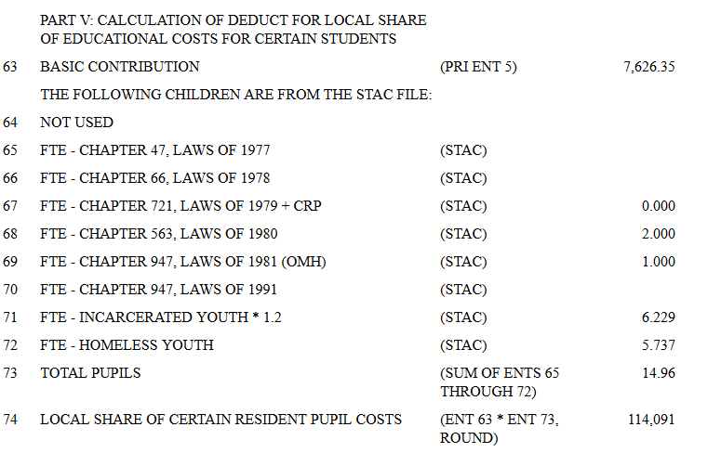
Local Share Deduction

Slide 26
Best Practice: STAC ID
  One STAC ID per child
    Multiple STAC IDs tied to same student causes confusion
  Before entering new student STAC ID
    Use Find a STAC ID
    Search using first and last name and DOB
  Watch for misspelled first and last names
  Incorrect DOB
  Middle Initials
  Incorrect ethnicity/gender

Slide 27
Best Practice: End Dates
If a student exits your district, be sure to end date STAC
  This will allow new district to enter STAC timely
    STAC Error Message: overlapping service dates with “x” district

Slide 28
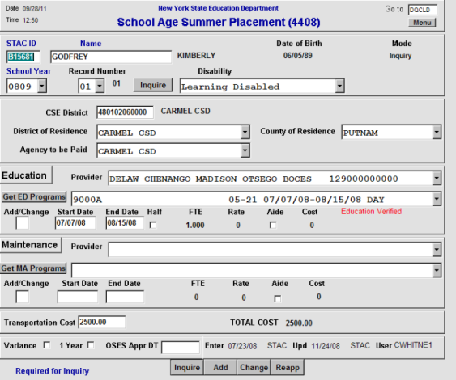
Amending a STAC

Slide 29
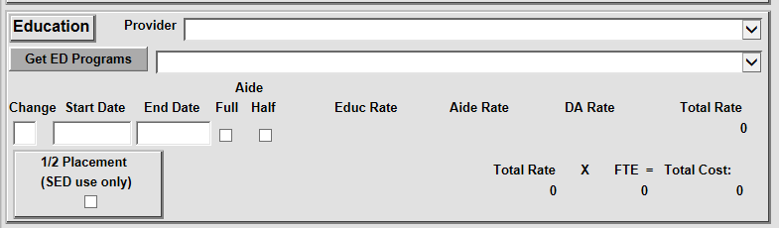
Aide Enhancement

Slide 30
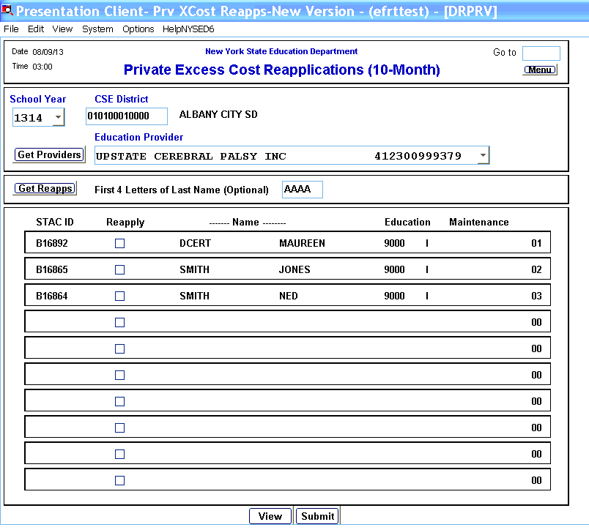
Reapplications

Slide 31
Online Verification Process:
Online
  10-month Public
  10-month Private
  10-month 4201
  4201 Schools
  Summer 4408 (Education & Transportation)
    9015 A-D Program (Education & Transportation)
  Homeless
  Incarcerated Youth

Slide 32
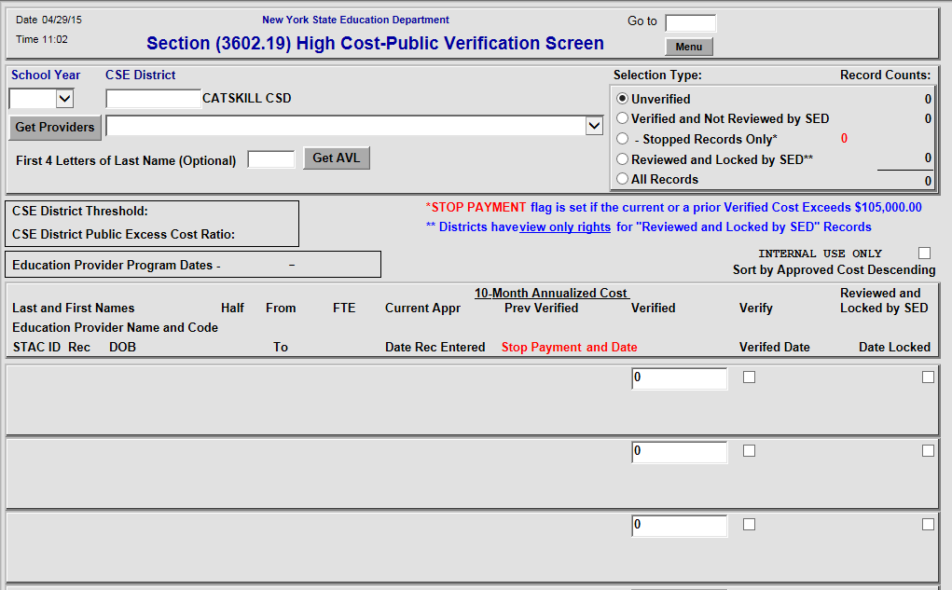
DVPUB Online Verifications – High Cost Public Placements

Slide 33
4201 State-Supported Schools
Districts responsible for reapplication/STAC & verification
State-supported schools:
  Cleary School for the Deaf
  Henry Viscardi School
  Lavelle School for the Blind
  Lexington School for the Deaf
  Mill Neck Manor School for Deaf
  NY Institute for Special Education
  New York School for the Deaf
  Rochester School for the Deaf
  St. Francis de Sales School for the Deaf
  St. Joseph’s School for the Deaf
  St. Mary’s School for the Deaf

Slide 34
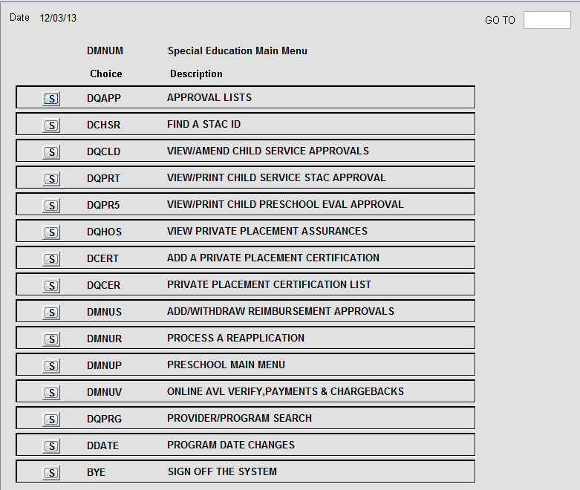
NYSED STAC Online System

Slide 35
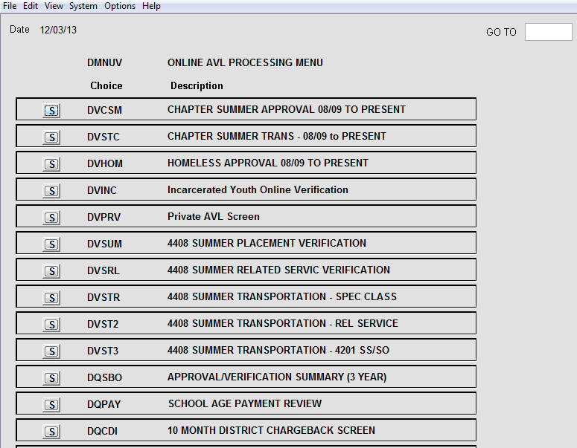
Reports to Monitor
Description:
DQSBO: 3 year comparison of STACs filed
DQPAY: Displays APR Reports
(Students names, dates and amount paid to date)
DQCDI: District Chargeback Listing

Slide 36
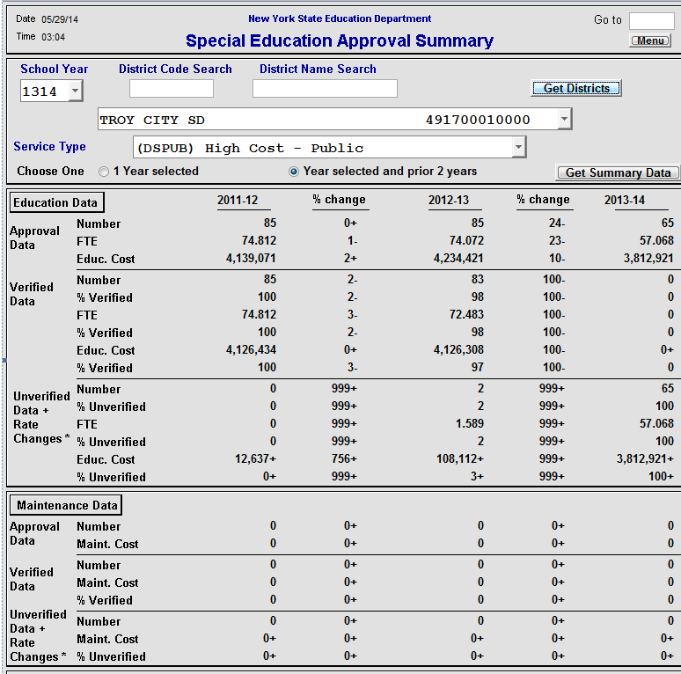
DQSBO Report

Slide 37
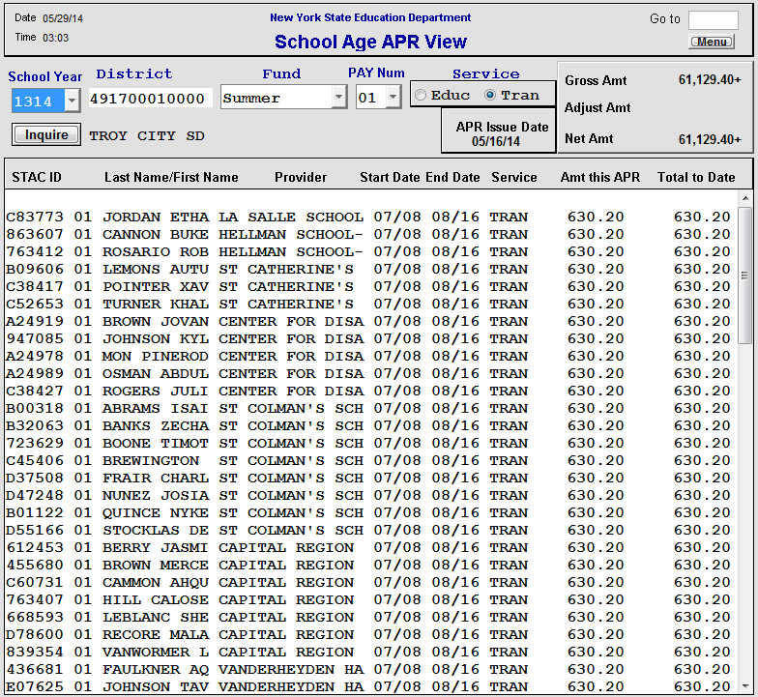
DQPAY Report

Slide 38
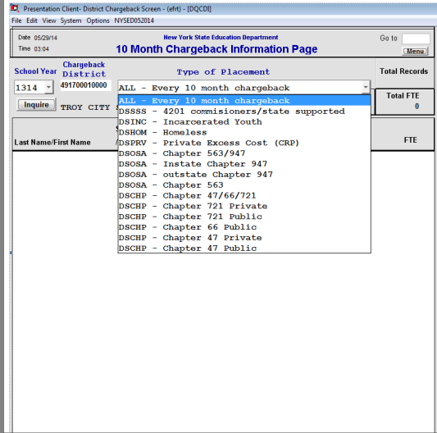
DQCDI Report

Slide 39
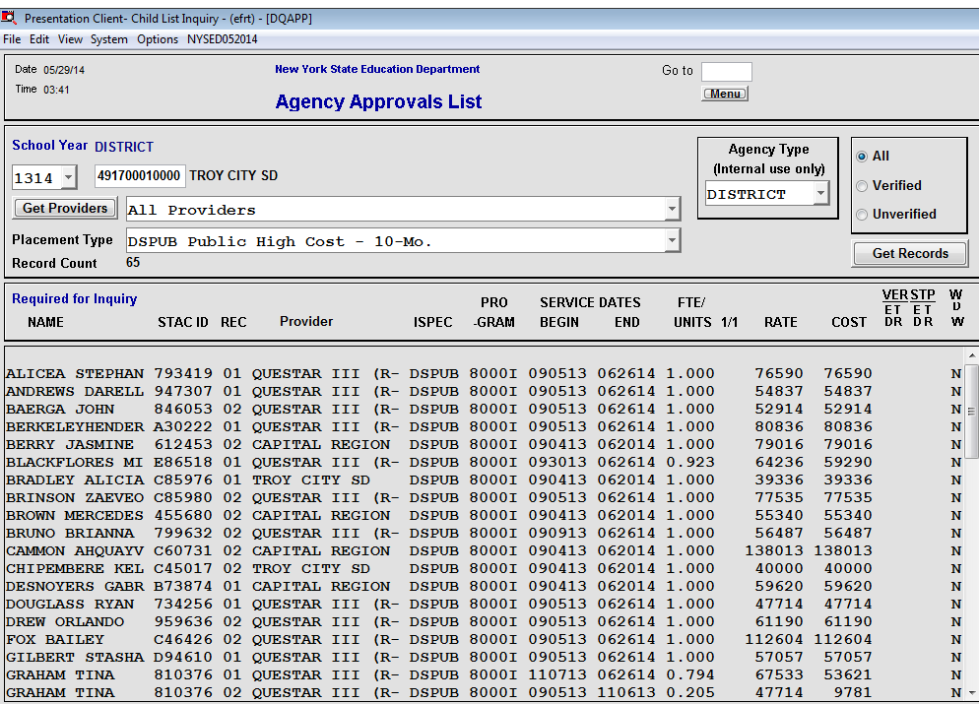
DQAPP – Approval List

Slide 40
Gold Star Report
Online Report Displaying Verifications
  Enrollment Period, Online Verification Reports and Online Verification Instructions
Updated on a monthly basis
  http://www.oms.nysed.gov/stac/schoolage/avl-payment_reports_and_chargebacks/online_verification_status.html
Changes to an approval may require re-verification
  Monitor the Gold Star reports
Only displays STACS entered

Slide 41
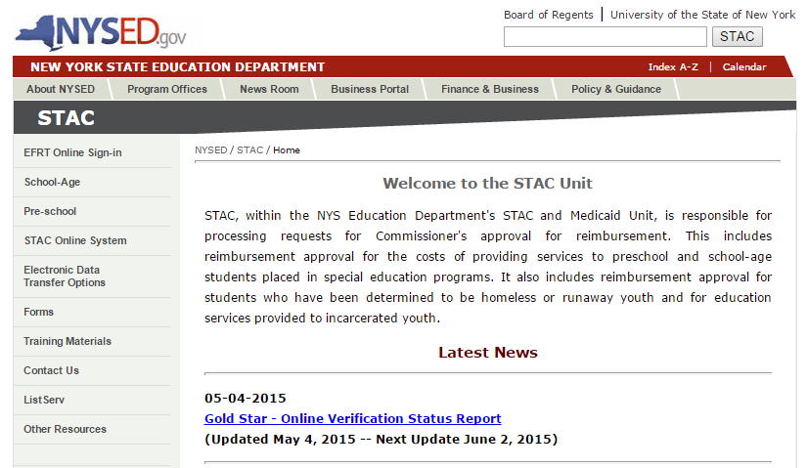
Where to find Gold Star Link

Slide 42
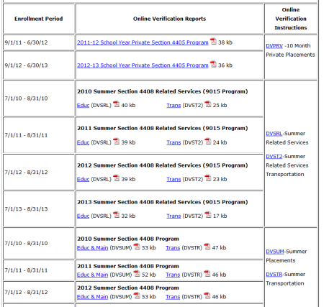
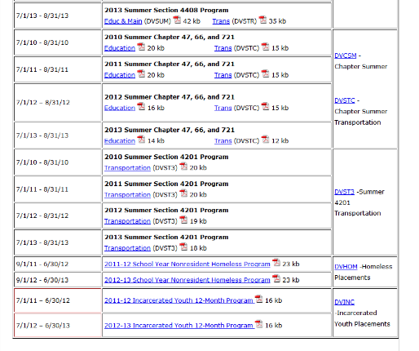
NYSED Gold Star Report
http://www.oms.nysed.gov/stac/schoolage/avlpayment_reports_and_chargebacks/online_verification_status.html

Slide 43
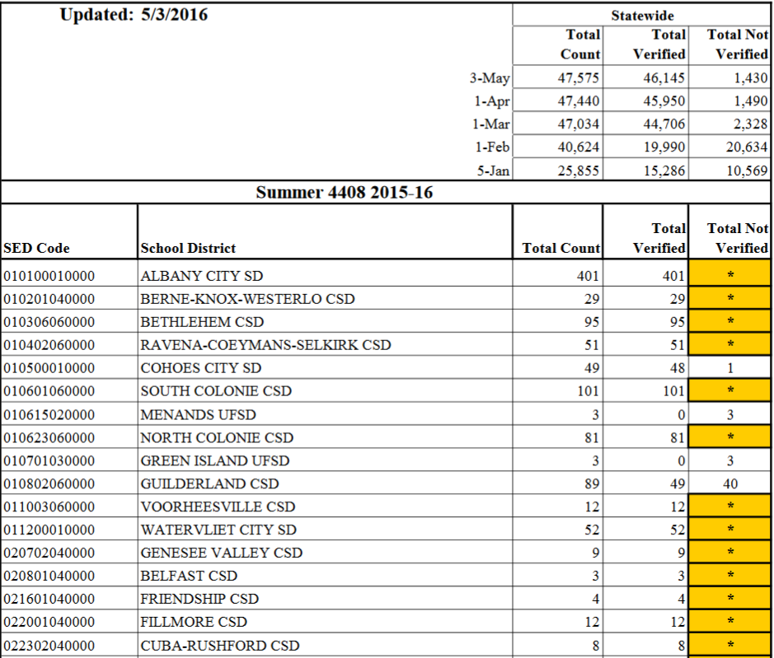
NYSED Gold Star Report

Slide 44
Common Errors
If a change is made after verification, re-verify placement
Shared Aide, Half-time Aide, LPN, RN, or Interpreter (not BOCES) need supplemental form
Cannot add additional related services to private placements – rate set by SED

Slide 45
Tips for Success
  Be familiar with the STAC on-line system provided by NYSED
  Utilize screens to determine completion of STAC process
  Effective communication between Special Education/CSE and the Business Office is crucial
  Submit STAC information in a timely fashion
  Utilize Calendars
  Record keeping
  Reference output reports

Slide 46
Contact Information
Questar III
State Aid & Financial Planning Service
10 Empire State Blvd.
Castleton, NY 12033
(518) 477-2635
Fax (518) 477-4284
http://sap.questar.org
twitter.com/qiiisap - @qiiisap

